Slide 1
Model View Controller (MVC) Design Pattern
By James Moran

Slide 2
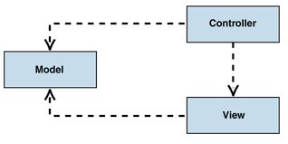
What is the MVC?
MVC Overview
Model
View
Controller
(Microsoft, © 2018a)
MVC Class Structure Diagram
(Microsoft, © 2018b)

Slide 3
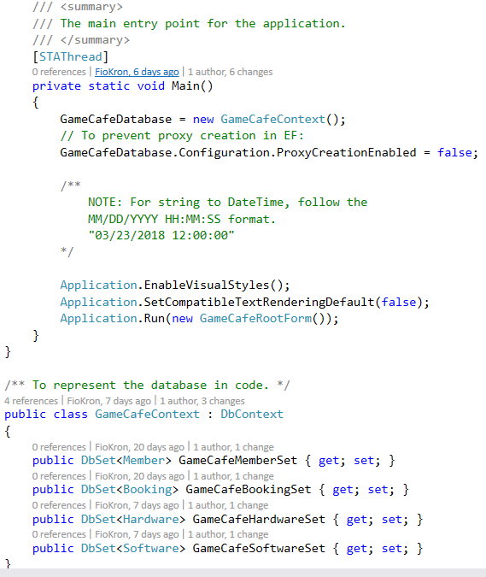
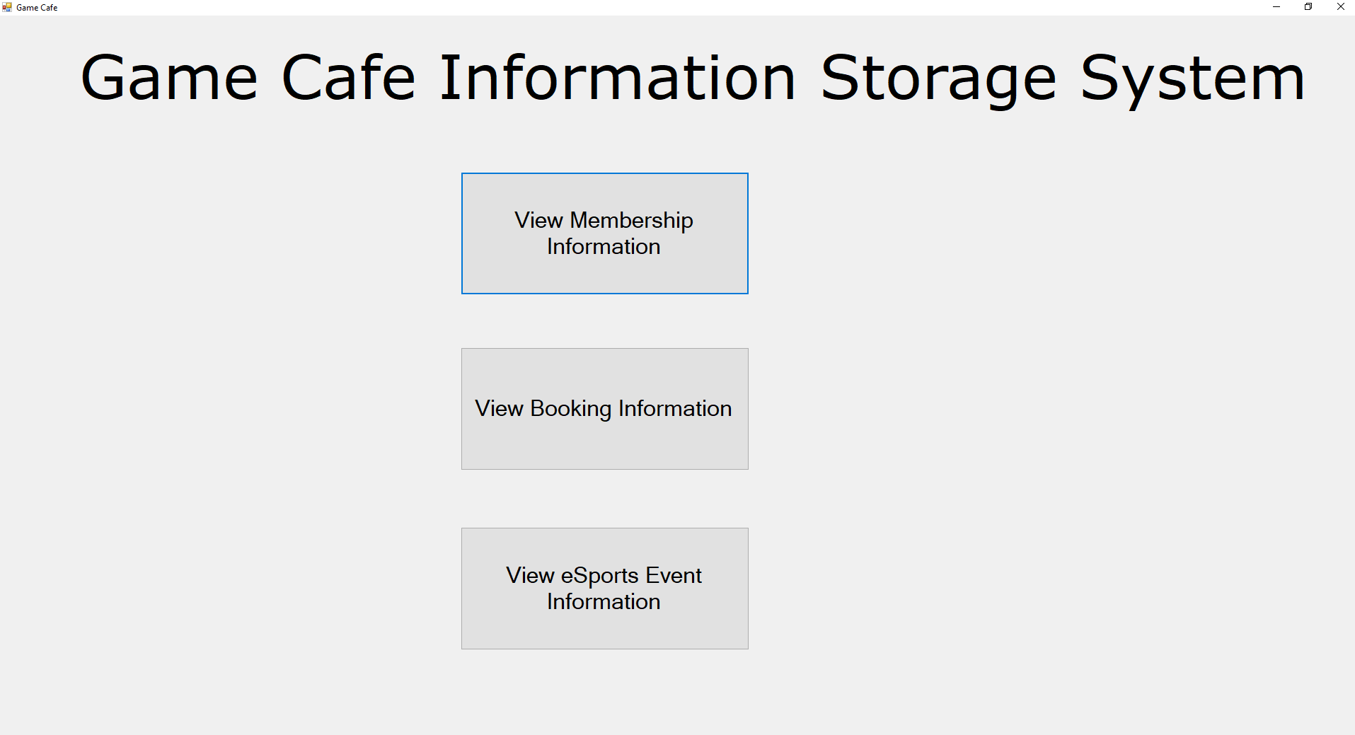
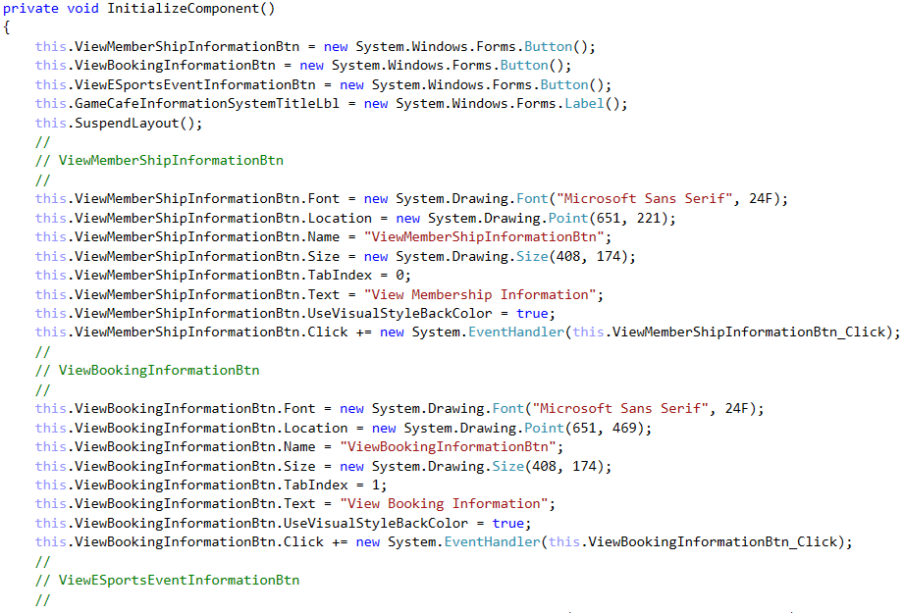
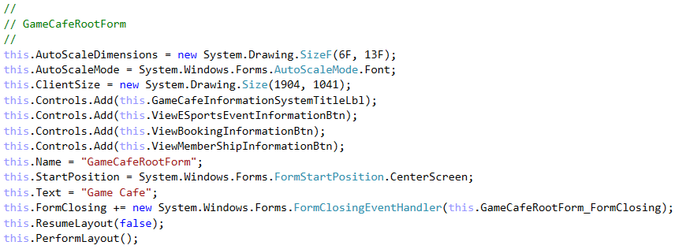
Usage in the Game Café
Model
View
Controller

Slide 4
Advantages and Disadvantages of the MVC Pattern
Advantages
Supports Multiple Views
Accommodates Change
Disadvantages
Complexity
Cost of Frequent Updates
(Microsoft, © 2018c)

Slide 5

References
MICROSOFT, © 2018a. Model-View-Controller [Viewed on the 27/03/2018]. Available from: https://msdn.microsoft.com/en-us/library/ff649643.aspx
MICROSOFT, © 2018b. MVC class structure [Digital Image] [Viewed on the 27/03/2018]. Available from: https://msdn.microsoft.com/en-us/library/ff649643.aspx (Figure 1: IC114765.gif)
MICROSOFT, © 2018c. Model-View-Controller (Resulting Context Header)[Viewed on the 27/03/2018]. Available from: https://msdn.microsoft.com/en-us/library/ff649643.aspx
Notes:
This slide details the references used in this presentation, thank-you for watching this presentation.

